Slide 1
EE359 – Lecture 4 Outline
Announcements:
  No OHs today.
  1st HW due tomorrow.
Review of Last Lecture
Model Parameters from Empirical Data
Random Multipath Model
Time Varying Channel Impulse Response
Narrowband Approximation for RX Signal
In-phase and Quadrature RX Signal Components

Slide 2
Review of Last Lecture
Log Normal Shadowing
Combined Path Loss and Shadowing
Cell Coverage Area

Slide 3
Model Parameters from
Empirical Measurements
K (dB)
2
σ_{ψ}
P_{r}(dB)
Fit model to data
Path loss (K,γ), d₀ known:
  “Best fit” line through dB data
  K obtained from measurements at d₀.
  Exponent is MMSE estimate based on data
  Captures mean due to shadowing
Shadowing variance
  Variance of data relative to path loss model (straight line) with MMSE estimate for γ
10γ
log(d)
log(d₀)

Slide 4


Statistical Multipath Model
Random # of multipath components, each with
  Random amplitude
  Random phase
  Random Doppler shift
  Random delay
Random components change with time
Leads to time-varying channel impulse response

Slide 5
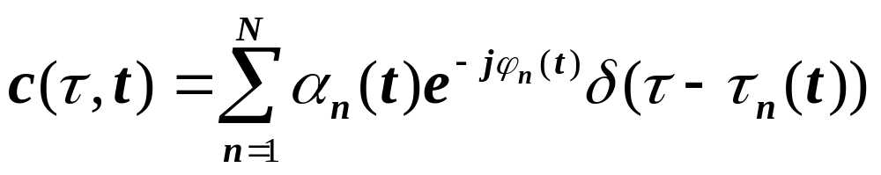
Time Varying Impulse Response
Response of channel at t to impulse at t-τ:
  t is time when impulse response is observed
  t-τ is time when impulse put into the channel
  τ is how long ago impulse was put into the channel for the current observation
    path delay for MP component currently observed

Slide 6
Received Signal Characteristics
Received signal consists of many multipath components
Amplitudes change slowly
Phases change rapidly
  Constructive and destructive addition of signal components
  Amplitude fading of received signal (both wideband and narrowband signals)

Slide 7
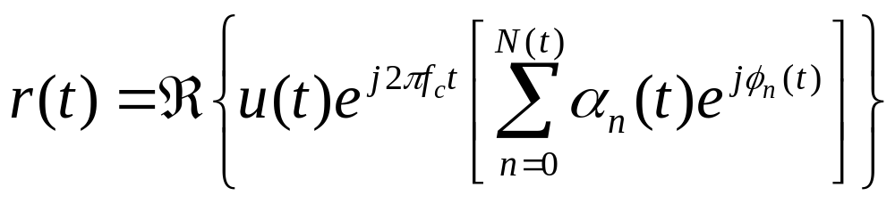
Narrowband Model
Assume delay spread max_{m,n}|τ_{n}(t)-τ_{m}(t)|<<1/B
Then u(t)≈u(t-τ).
Received signal given by
No signal distortion (spreading in time)
Multipath affects complex scale factor in brackets.
Characterize scale factor by setting u(t)=δ(t)

Slide 8
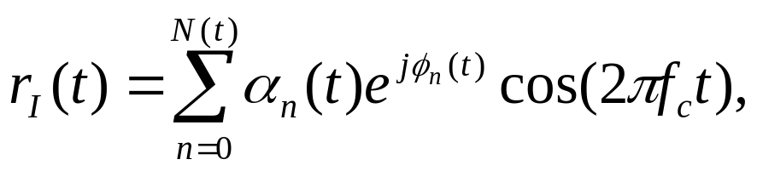
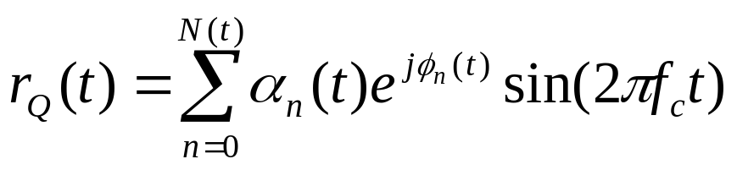
In-Phase and Quadrature under CLT Approximation
In phase and quadrature signal components:
For N(t) large, r_{I}(t) and r_{Q}(t) jointly Gaussian (sum of large # of random vars).
Received signal characterized by its mean, autocorrelation, and cross correlation.
If ϕ_{n}(t) uniform, the in-phase/quad components are mean zero, indep., and stationary.

Slide 9
Main Points
Statistical multipath model leads to a time-varying channel impulse response
Received signal has random amplitude fluctuations
Narrowband model and CLT lead to in-phase/quad components that are stationary Gaussian processes
  Processes completely characterized by their mean, autocorrelation, and cross correlation.
Assuming uniform phase offsets, process is zero mean with joint expectation also zero.

